Slide 1

HOTEL BUSINESS INSIGHTS

Slide 2

agenda
About us
Product overview
Market overview
Growth strategy
Summary

Slide 3

About us
Exploring Booking Behavior, Cancellations, and Revenue Patterns
Analyze hotel booking data to uncover trends in cancellations, pricing, guest behavior, and seasonal demand.
Tools Used: Python (Pandas, Matplotlib, Seaborn), Power BI, SQL.
OBJECTIVE

Slide 4
Product overview
A data-driven solution designed to turn raw hotel booking information into meaningful insights — empowering teams to track performance, understand guest behavior, and optimize operational efficiency.

Slide 5

DATA DESCRIPTION
File: hotel.csv
Records: Over 1000 bookings
Key columns:
hotel, arrival_date_month, adr (Average Daily Rate)
is_canceled, reserved_room_type, country
is_repeated_guest, distribution_channel

Slide 6

Market overview

Slide 7
Market comparison
Dynamic pricing advantage
Low cancellation rate
Peak season dominance
Direct booking strength
High guest satisfaction
Superior occupancy
Data-driven operations

Slide 8
Competitive landscape
Established brand trust among global travelers
Robust online presence and booking convenience
Strong partnerships with travel platforms and agencies
Data-driven operational efficiency and forecasting
Adaptable to market trends and seasonal demand shifts
Competitive pricing with premium offerings
Highly rated customer satisfaction and service quality

Slide 9
Growth strategy
Expand market reach through seasonal promotions and direct booking incentives
Enhance guest retention through personalized experiences and loyalty programs
Explore international market opportunities by targeting top guest countries with localized campaigns
Optimize revenue by leveraging room pricing analytics and booking trends
Reduce cancellations by improving refund policies and booking communication
Strengthen distribution by prioritizing high-performance booking channels
Expand
Foster collaborative growth
Enhance
Ensure a tailored and user-focused experience
Explore
Capitalize on emerging global markets

Slide 10
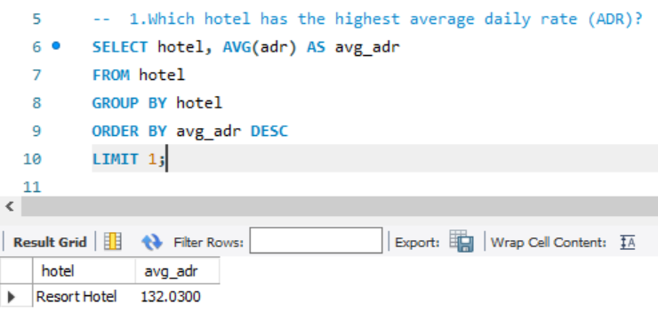
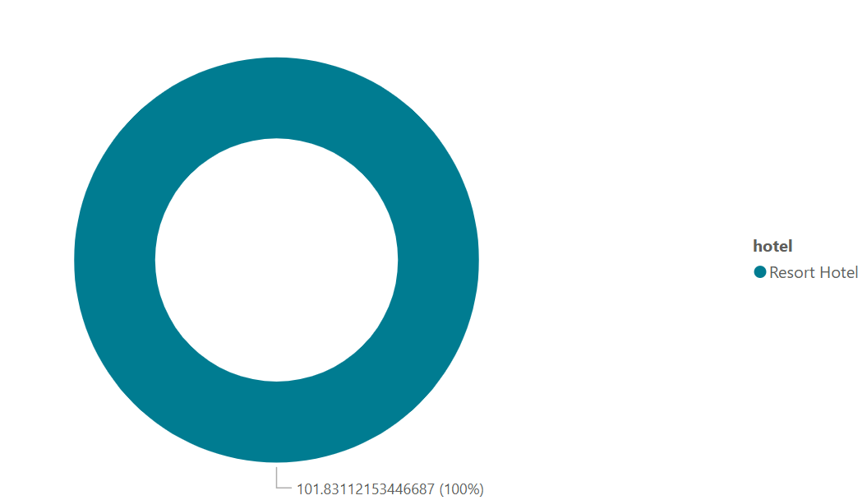
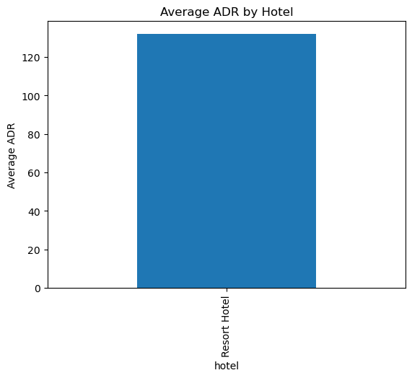
Average Daily Rate by Hotel Type
Identify which hotel type (City or Resort) earns more revenue per night. Helps with pricing strategy and positioning.
Resort hotels have higher ADR than city hotels.

Slide 11
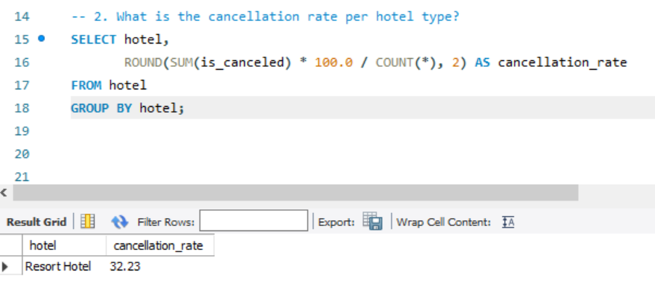
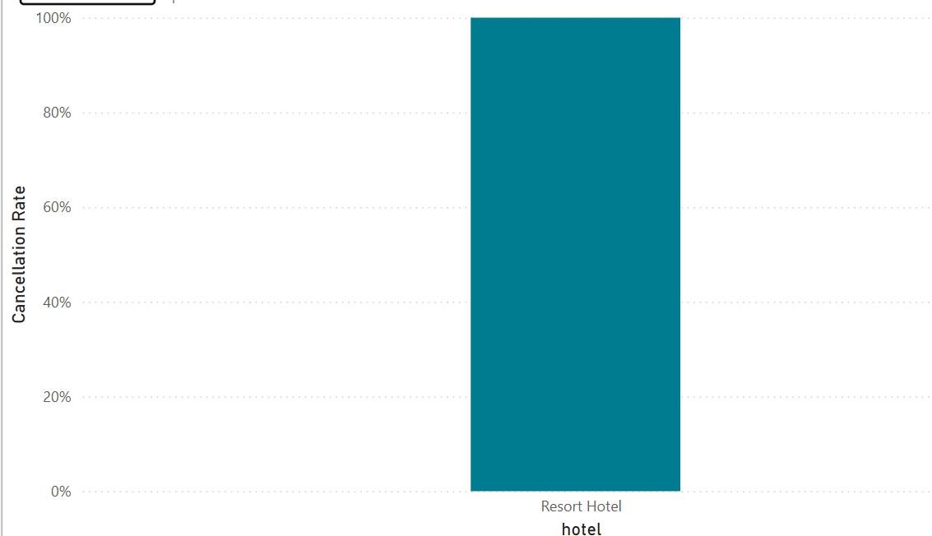
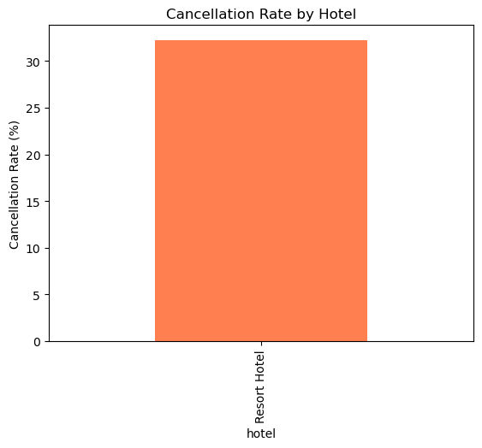
Cancellation Rate by Hotel Type
Compare cancellation behaviors between hotel types. Helps identify patterns that could affect occupancy and revenue.
Resort hotels have a higher cancellation rate (~40%).

Slide 12
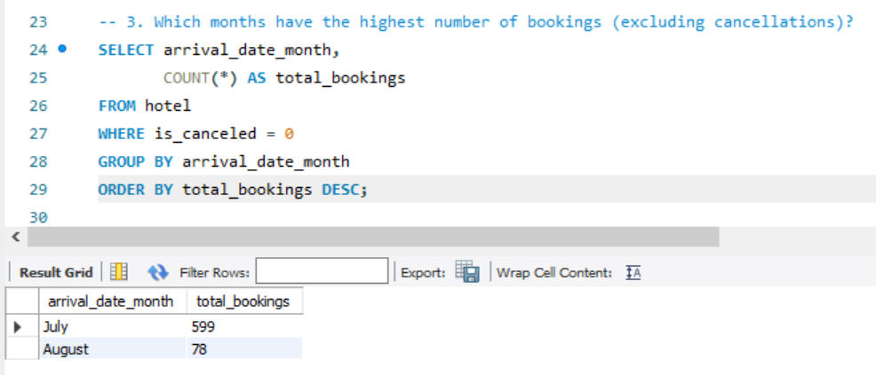
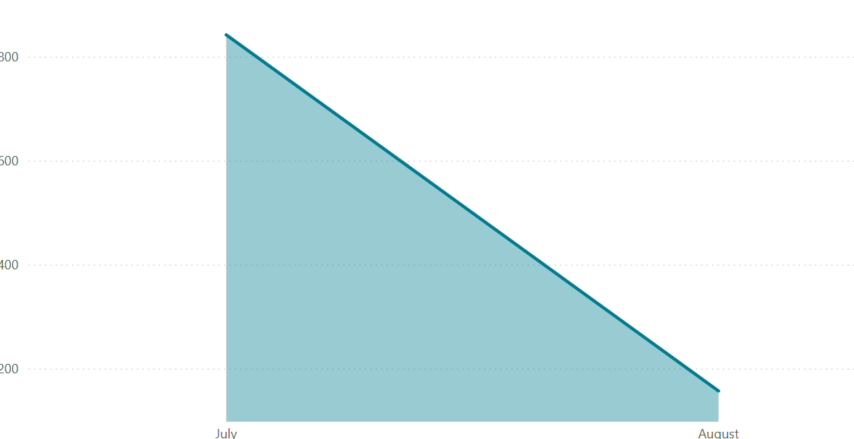
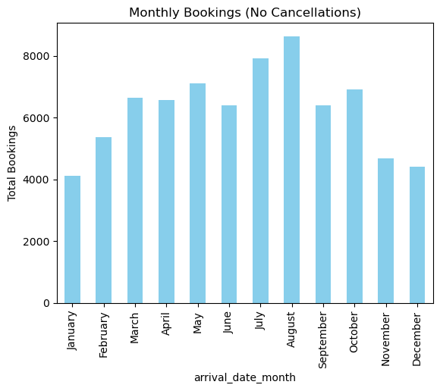
Monthly Booking Trends (Excluding Cancellations)
Understand seasonality and demand peaks to improve forecasting, staffing, and promotions.
Highest bookings in August, July.

Slide 13
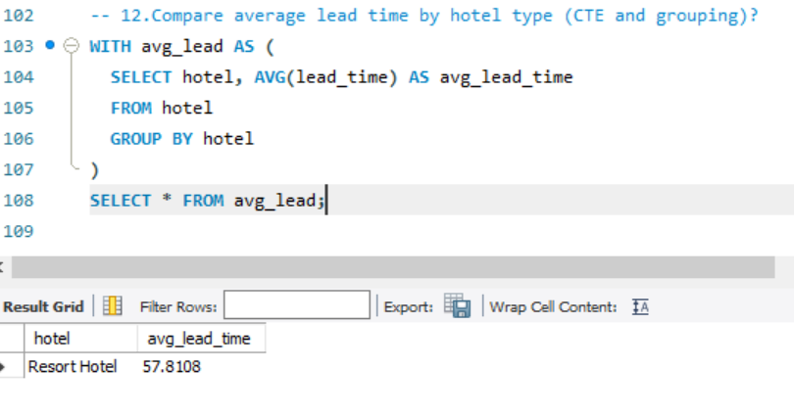
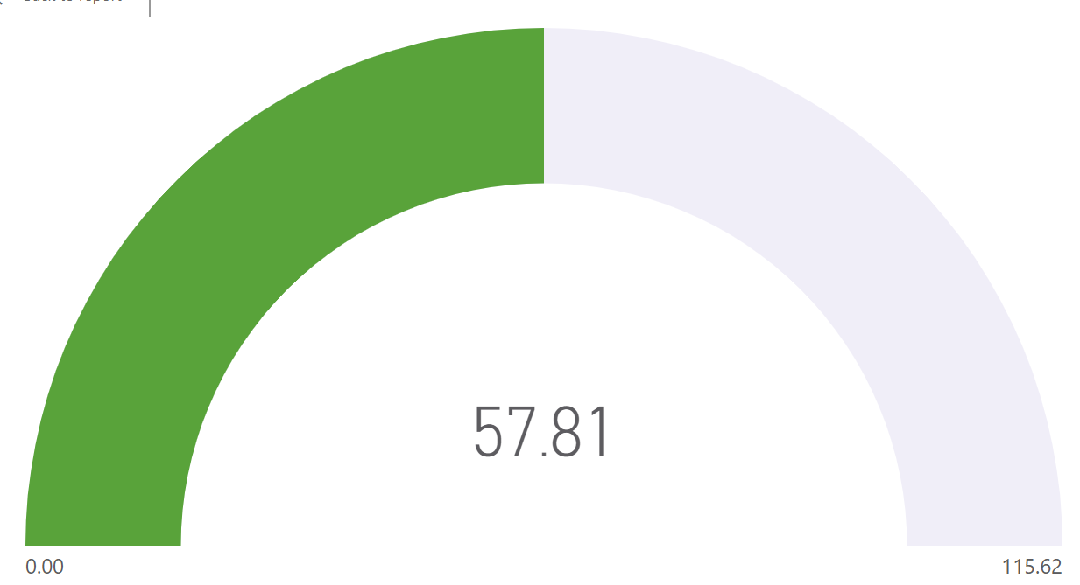
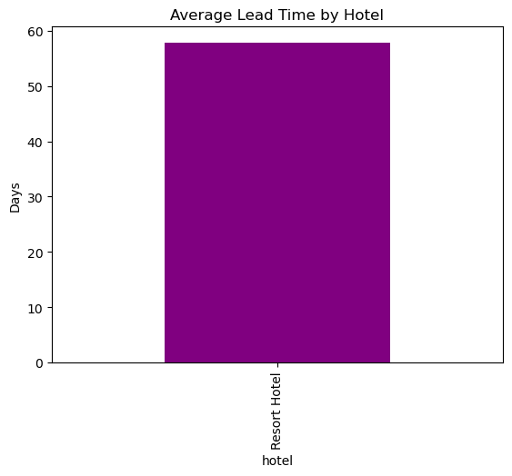
Average lead time by hotel
Understand how far in advance guests book at each hotel type — helps with demand forecasting, pricing strategy, and promotional timing.
Guests book Resort Hotels significantly earlier than City Hotels, indicating longer planning cycles for leisure stays.

Slide 14
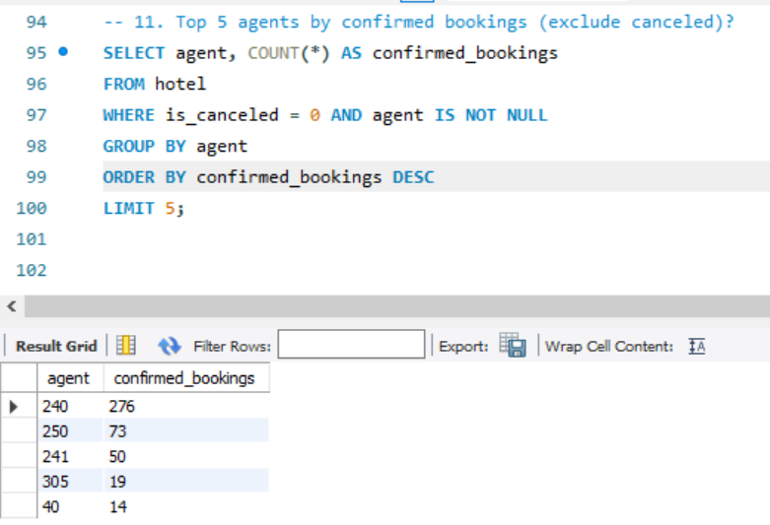
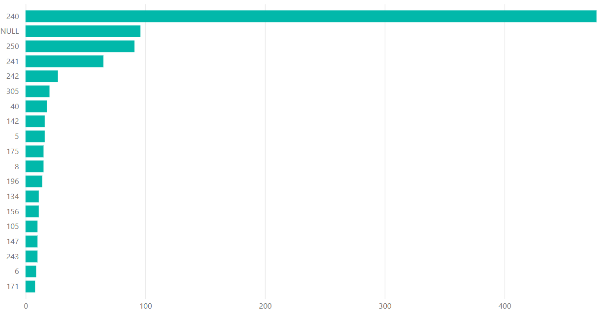
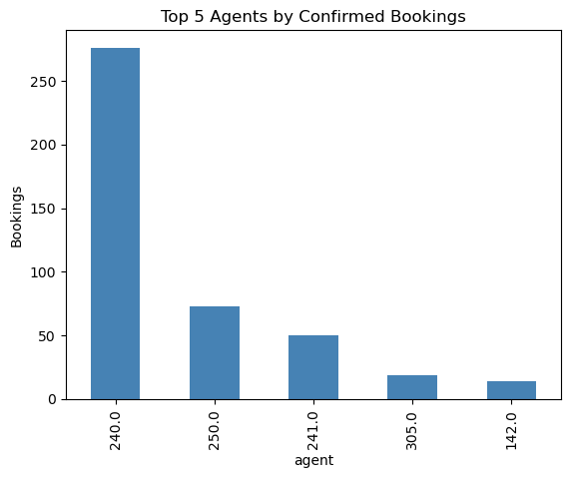
Top 5 agents by confirmed bookings
To identify the most valuable booking agents who bring in the highest number of confirmed (non-canceled) reservations — helping optimize partnership strategies and drive consistent occupancy.

Slide 15
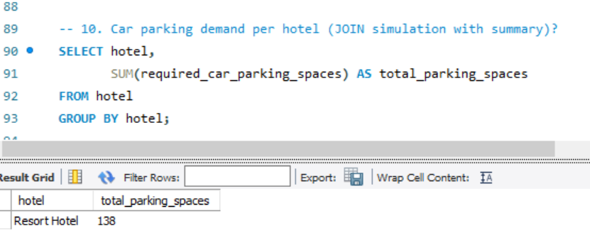
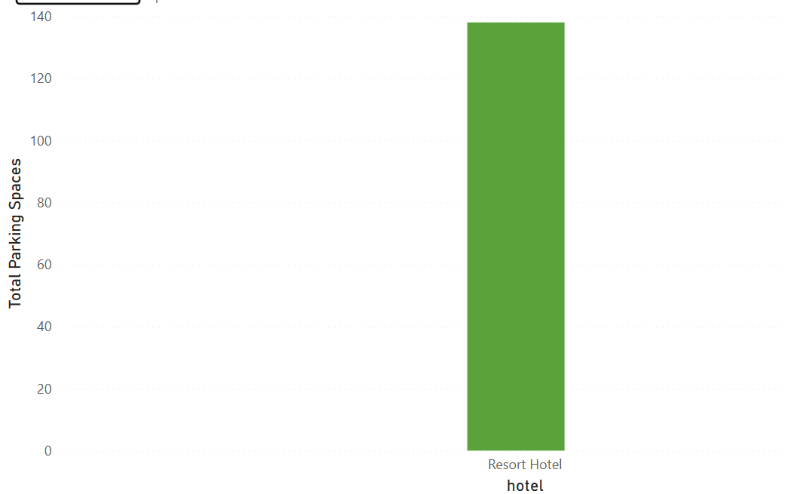
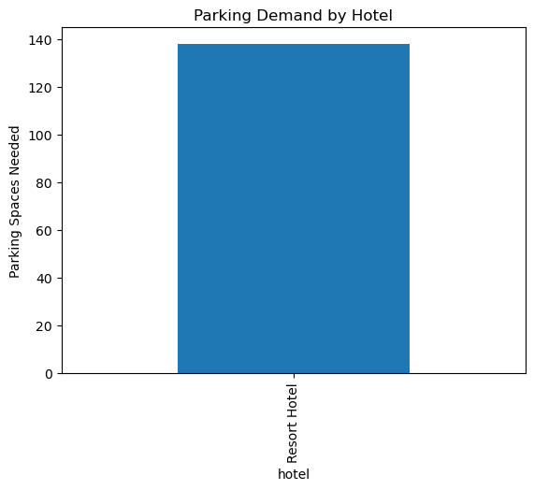
Parking demand by hotel
Understand guest parking needs across hotel types to plan parking space, pricing, and infrastructure.
Resort Hotels show higher parking demand than City Hotels, reflecting greater dependence on private transport for leisure stays.

Slide 16
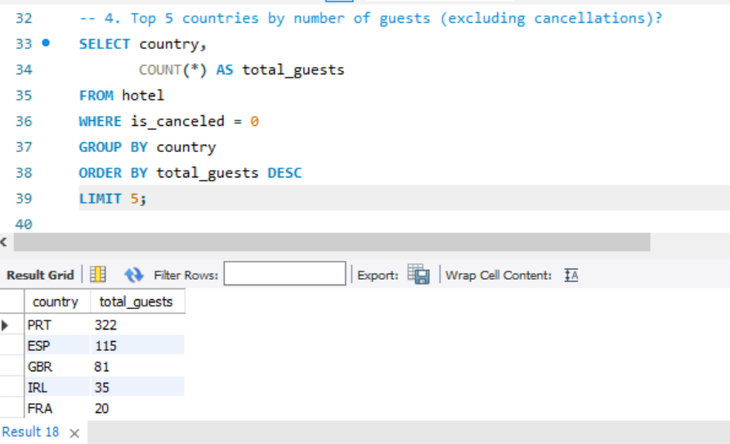
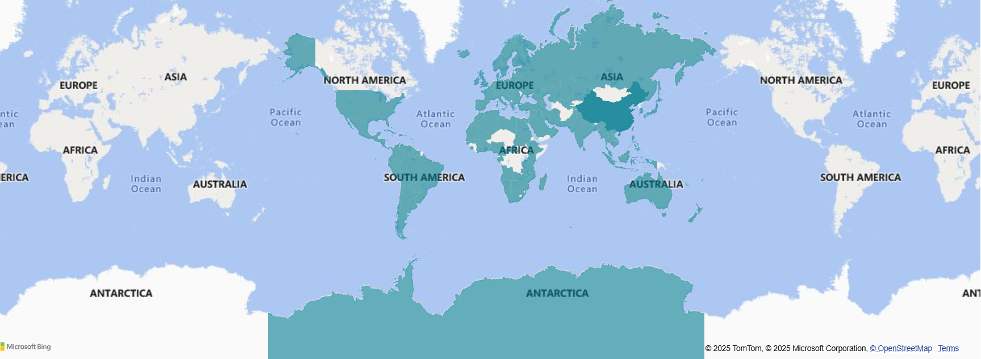
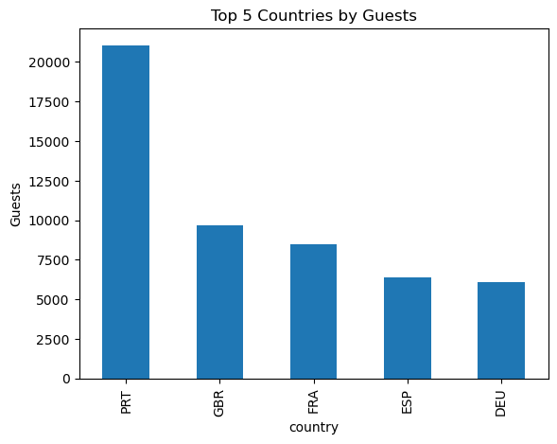
Top 5 Countries by Guest Volume
Identify key source markets to optimize marketing, tailor services, and support regional guest needs.
Portugal, United Kingdom, France, Spain, and Germany.

Slide 17
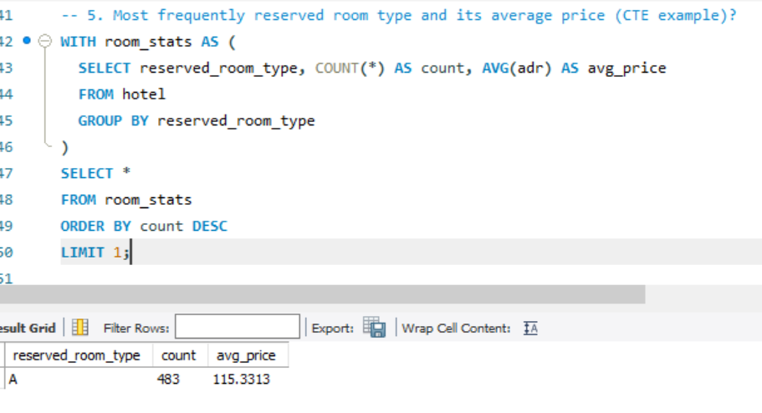
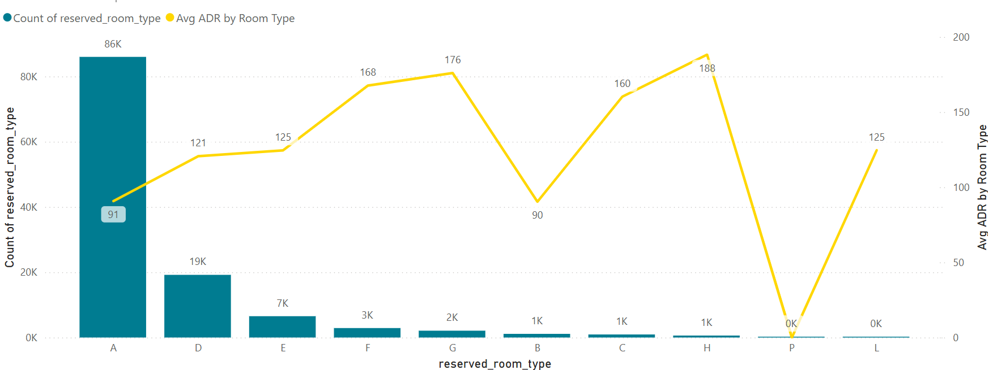
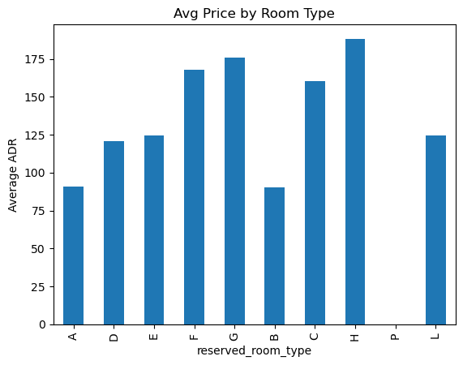
Room Type Insights
Understand customer preference for room types and evaluate if pricing matches demand. Useful for inventory planning and upselling.
Room type 'A' is most booked.
Room type 'H' has the highest average price.

Slide 18
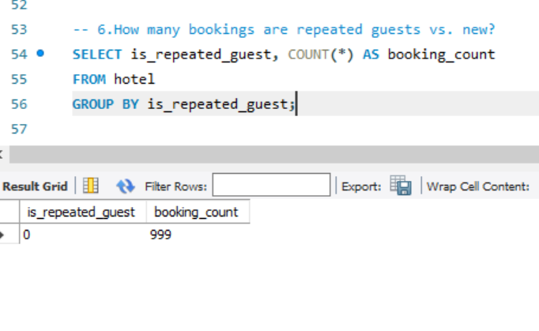
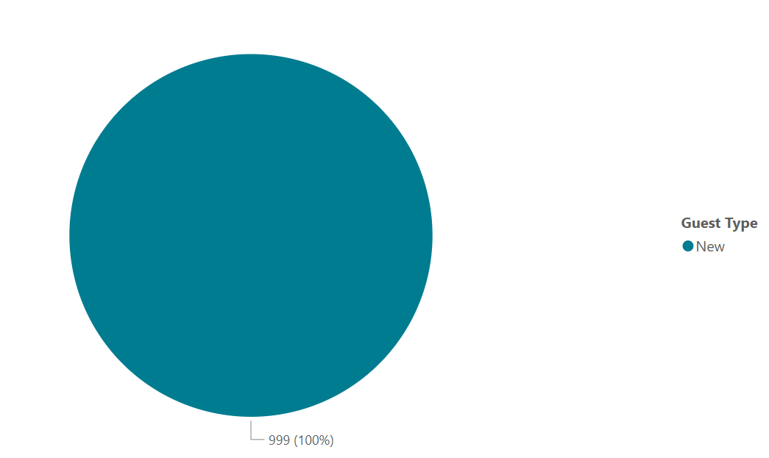
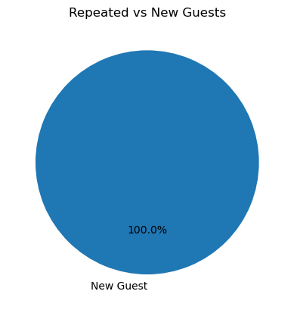
Guest Type Distribution
Understand customer loyalty. High repeated guests indicate satisfaction and reduce marketing acquisition costs.
Majority are new guests (100%).

Slide 19
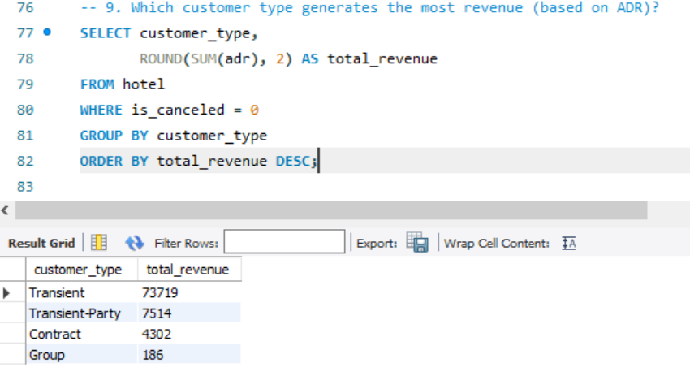
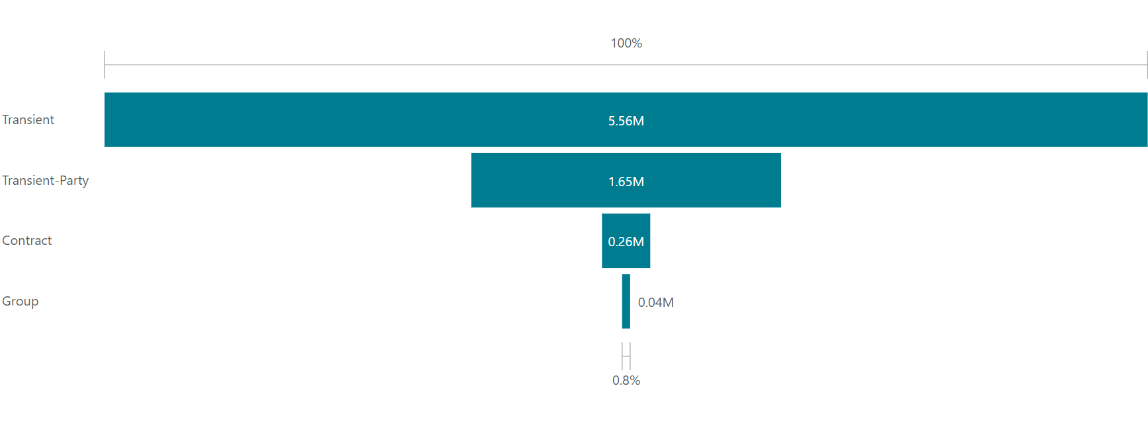
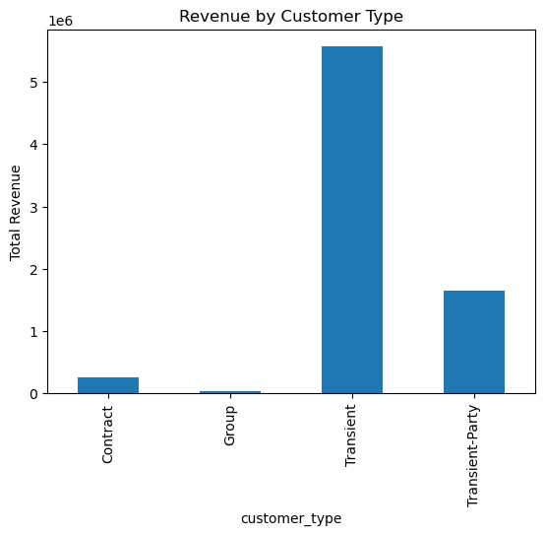
Average Daily Rate by CUSTOMER Type
Understand how much different customer segments are willing to pay — helps optimize pricing strategies and tailor offerings for each segment.
Transient Customer have higher ADR than others.

Slide 20
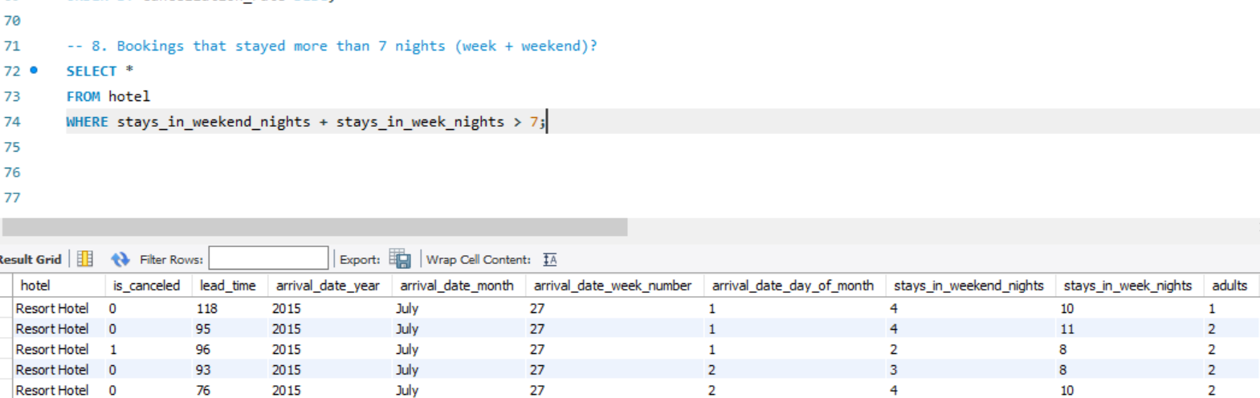
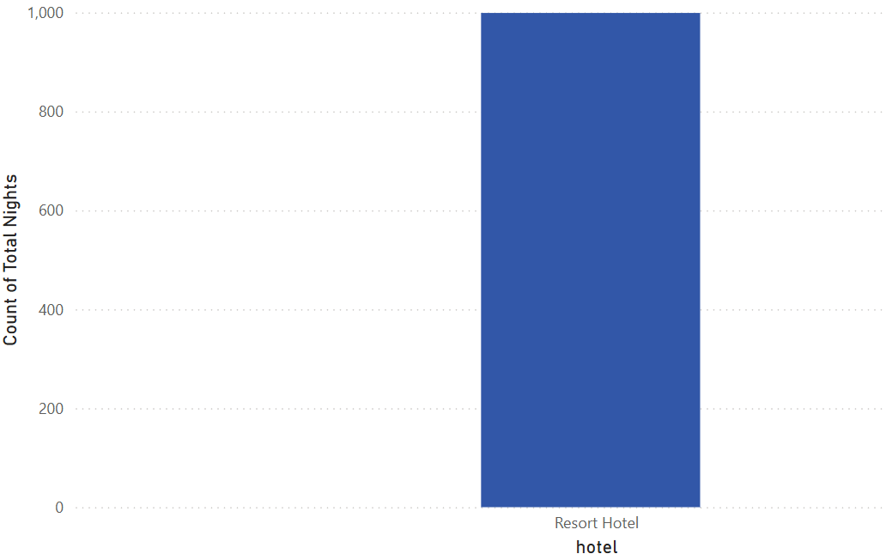
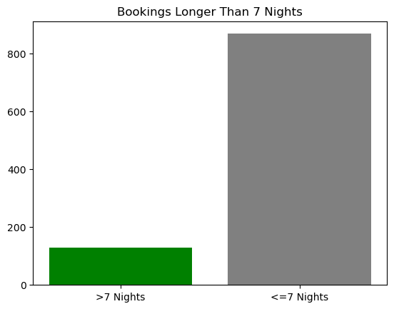
Bookings longer than 7 nights
Understand how many guests stay longer than a week — useful for targeting long-stay discounts, corporate deals, or vacation packages.

Slide 21
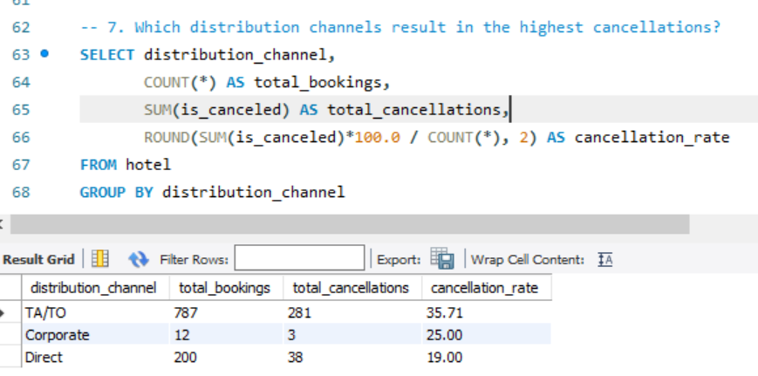
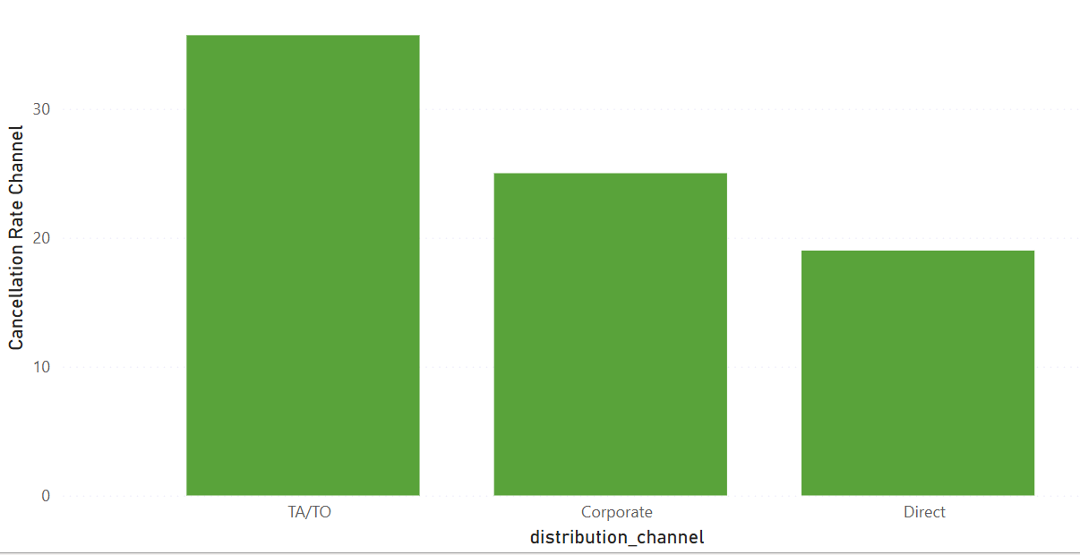
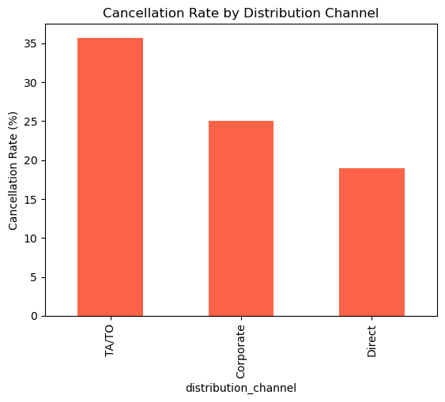
Cancellation rate by distribution channel
Identify which booking sources have higher cancellation behavior , helps optimize channel partnerships, reduce revenue loss, and focus on reliable sources.
Most bookings are coming through travel agents or tour operators rather than direct or corporate channels.

Slide 22
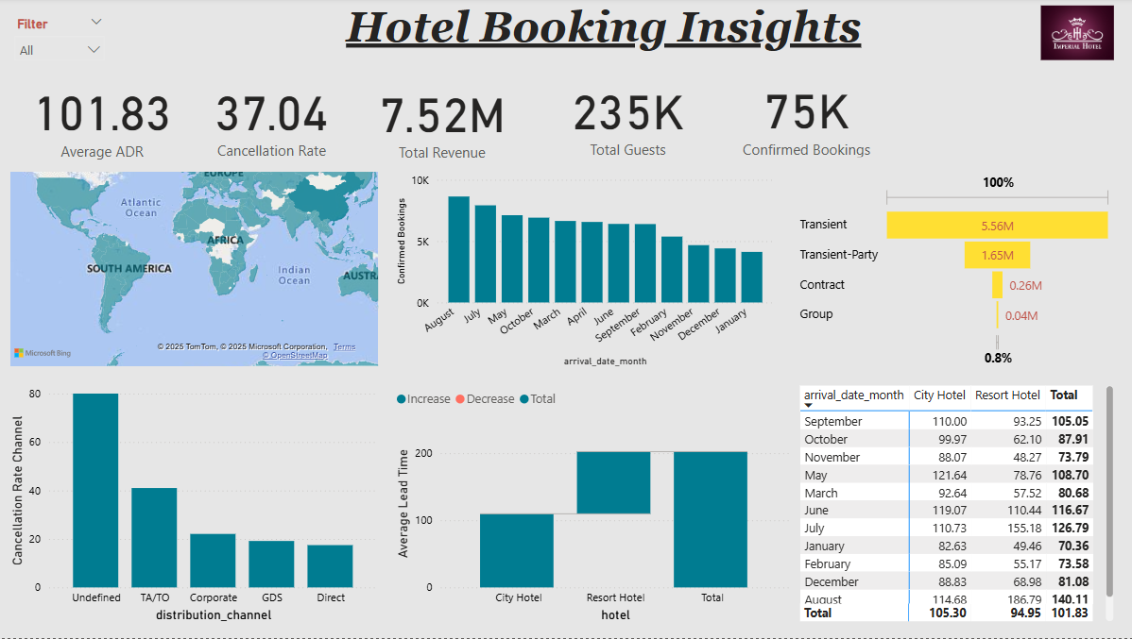
DASHBOARD

Slide 23
CONCLUSIONS
Resort hotels attract more revenue but also higher cancellations.
Seasonality strongly affects bookings (peak in summer).
Room type and country-level insights can guide targeted marketing
RECOMMENDATIONS
Offer incentives to reduce cancellations in resort hotels.
Target top guest countries with customized offers.
Optimize room pricing based on popularity and revenue.

Slide 24
thank you

